Slide 1
E-commerce billing and shopping
Modern college of arts, science nd commerse, ganeshkhind, pune-16
For academic year 2022-23, sy bba ca sem 4
Guided by: sheetal vekhande ma’am

Slide 2
contents
Introduction
Output windows
Main window
Adding product window
Deleting product window
View products window
Customer window
Backend processes
ER diagram
DFD diagram

Slide 3
introduction
This is an E-commerce project made using Python programming language along with MySQL. This project is about how a firm/individual shortlists their product on sale and how the consumer purchase it along with generation of the final bill of the purchase.
Important modules/libraries imported for this project are Tkinter for GUI (graphical user interface) along with MySQL.connector for connecting the backend of the project to the frontend of it.
This project can be used at billing systems in malls, shops, public service etc. online or offline.

Slide 4
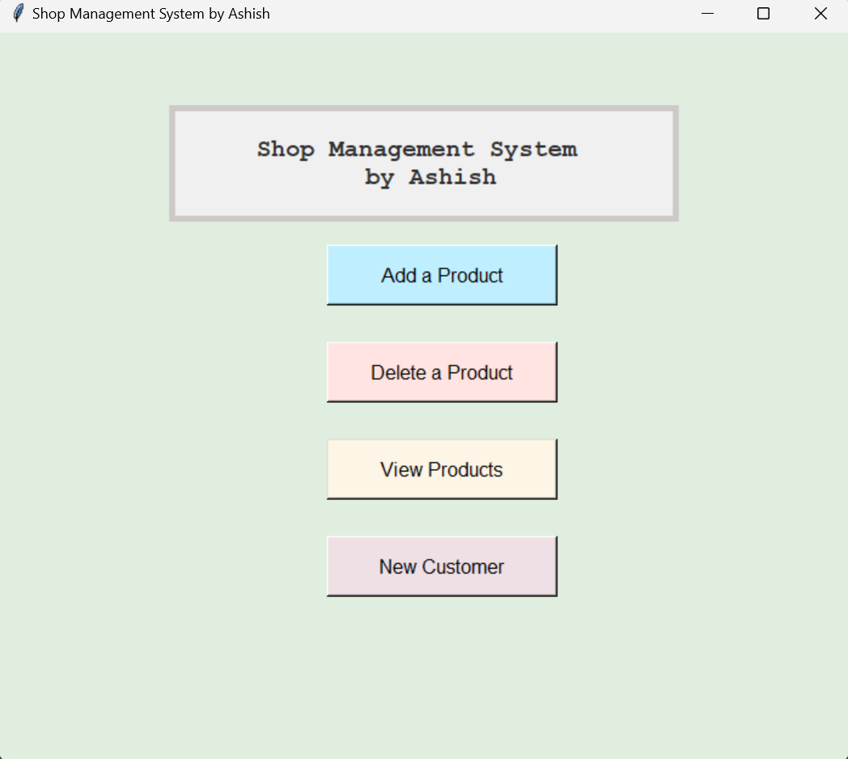
Output window main window

Slide 5
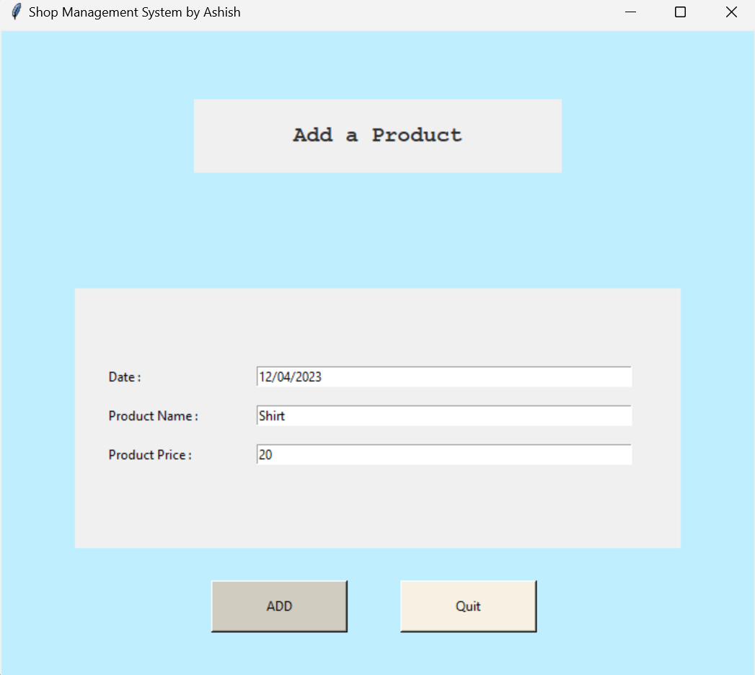
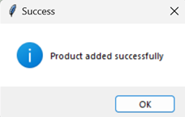
Adding product window

Slide 6
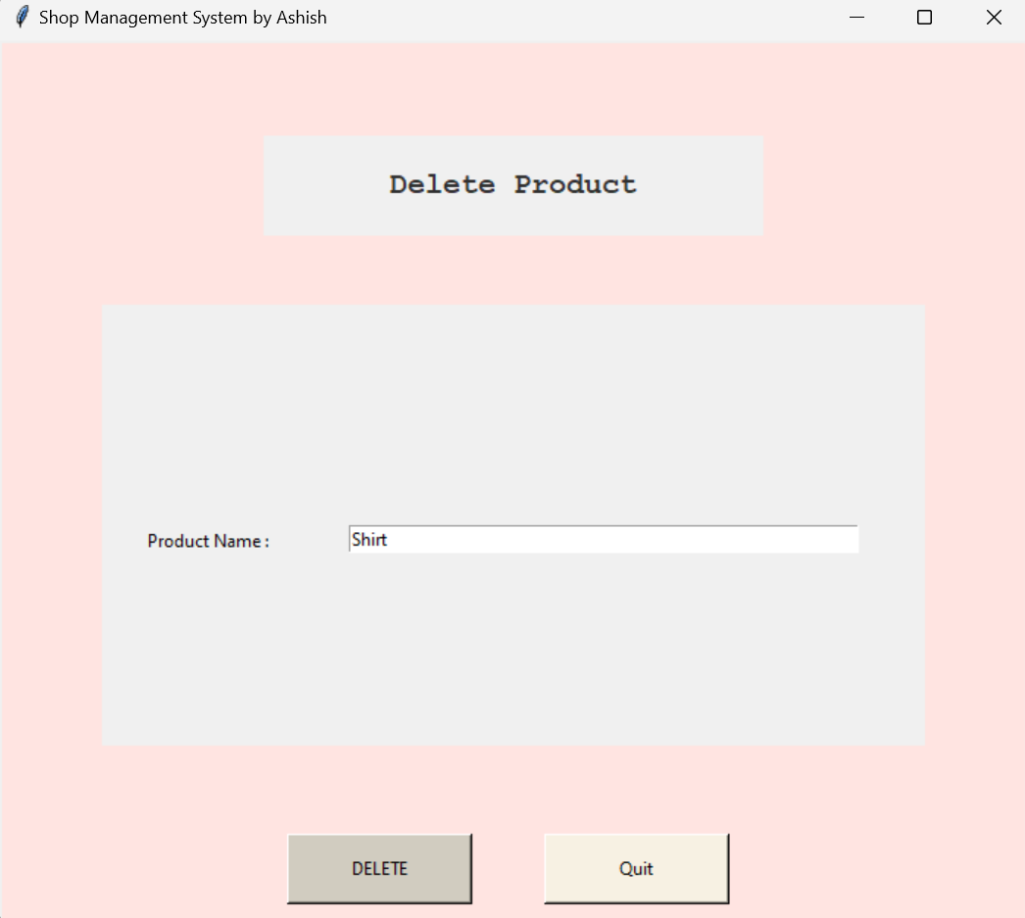
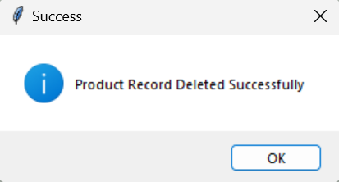
Deleting product window

Slide 7
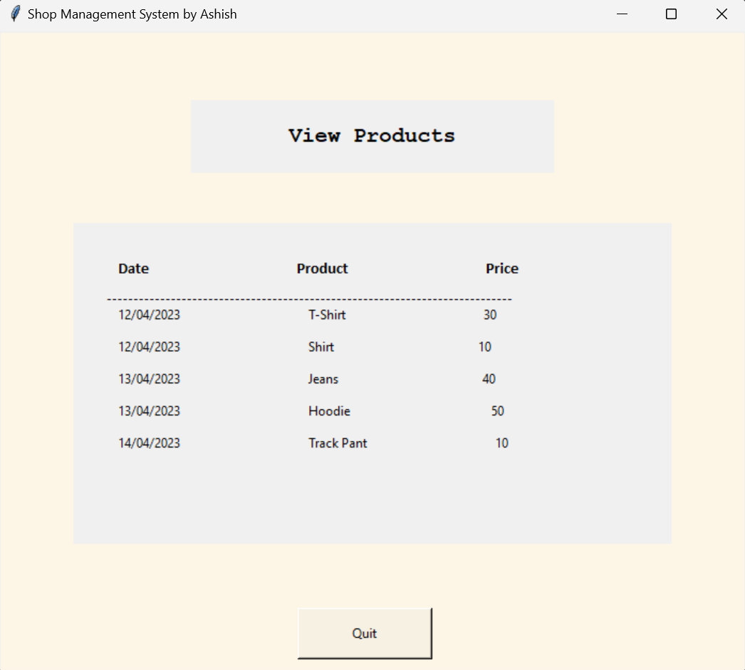
View product window

Slide 8
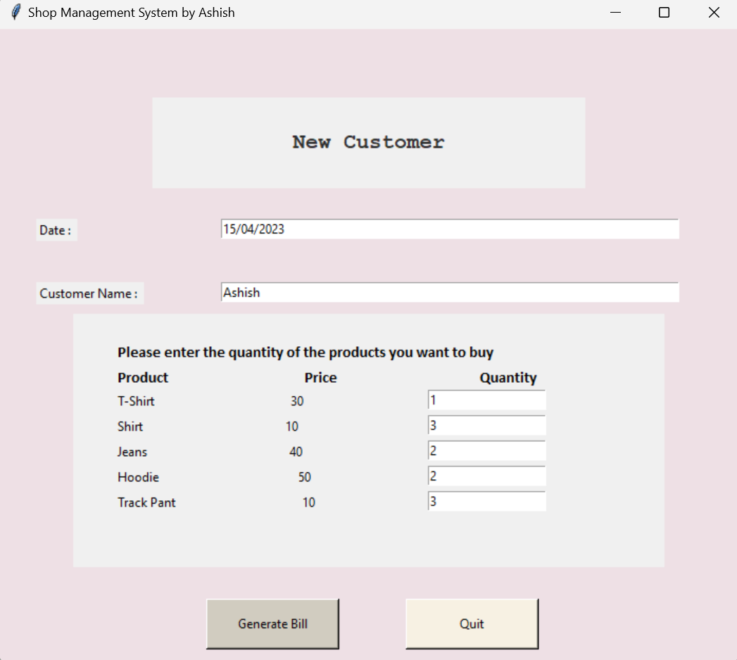
Customer window

Slide 9
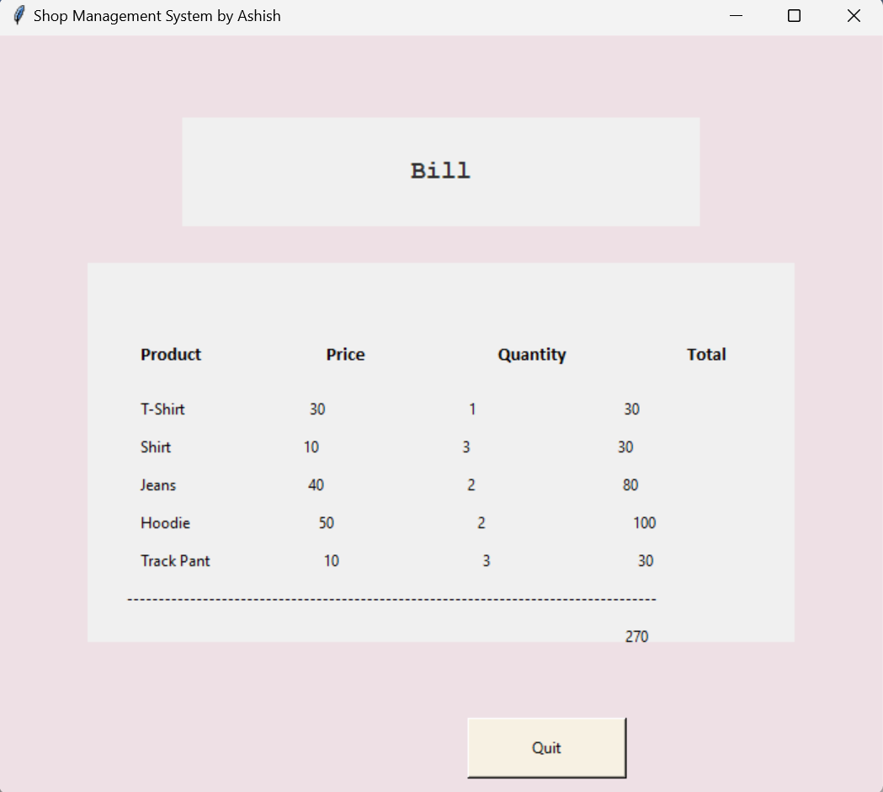
Bill generation window

Slide 10
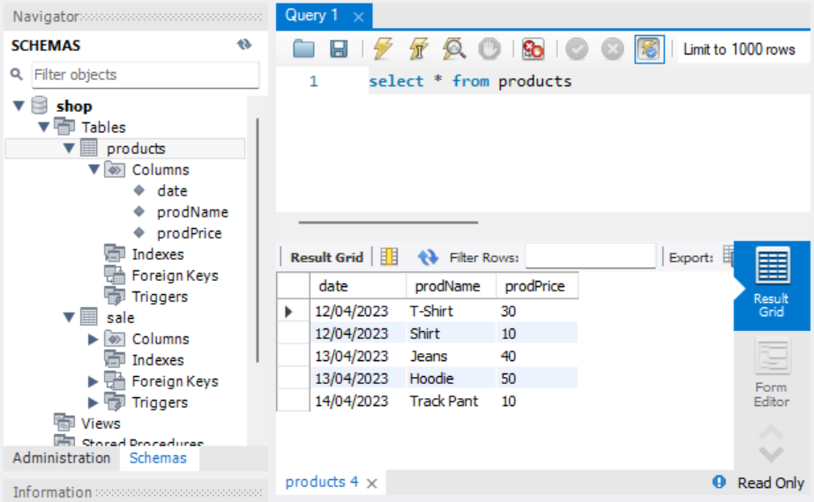
Backend processes: Mysql database

Slide 11
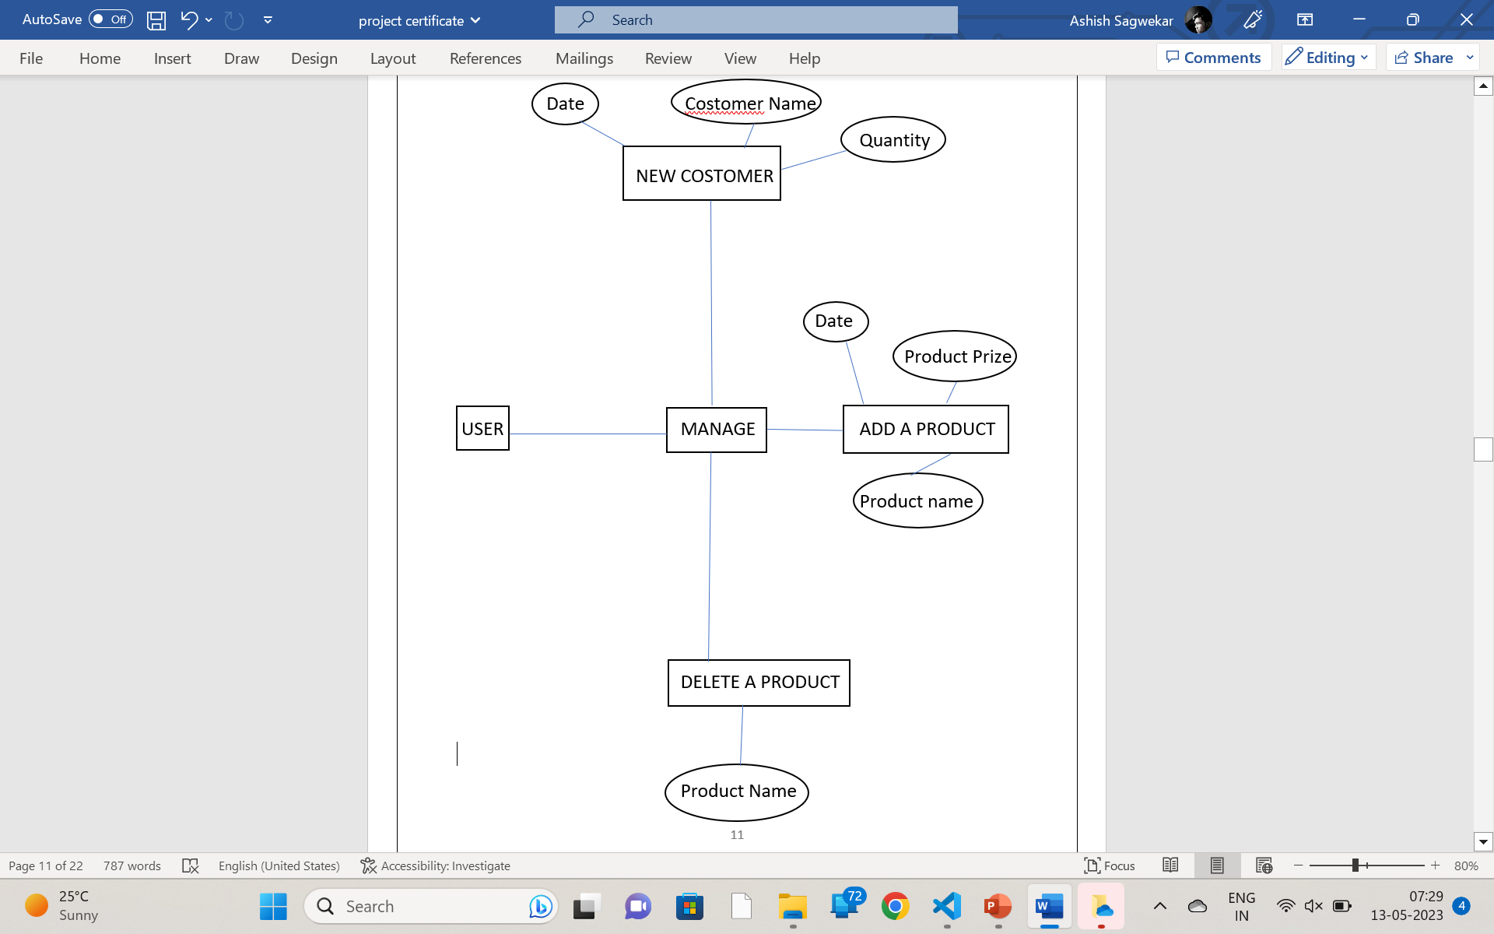
ER diagram

Slide 12
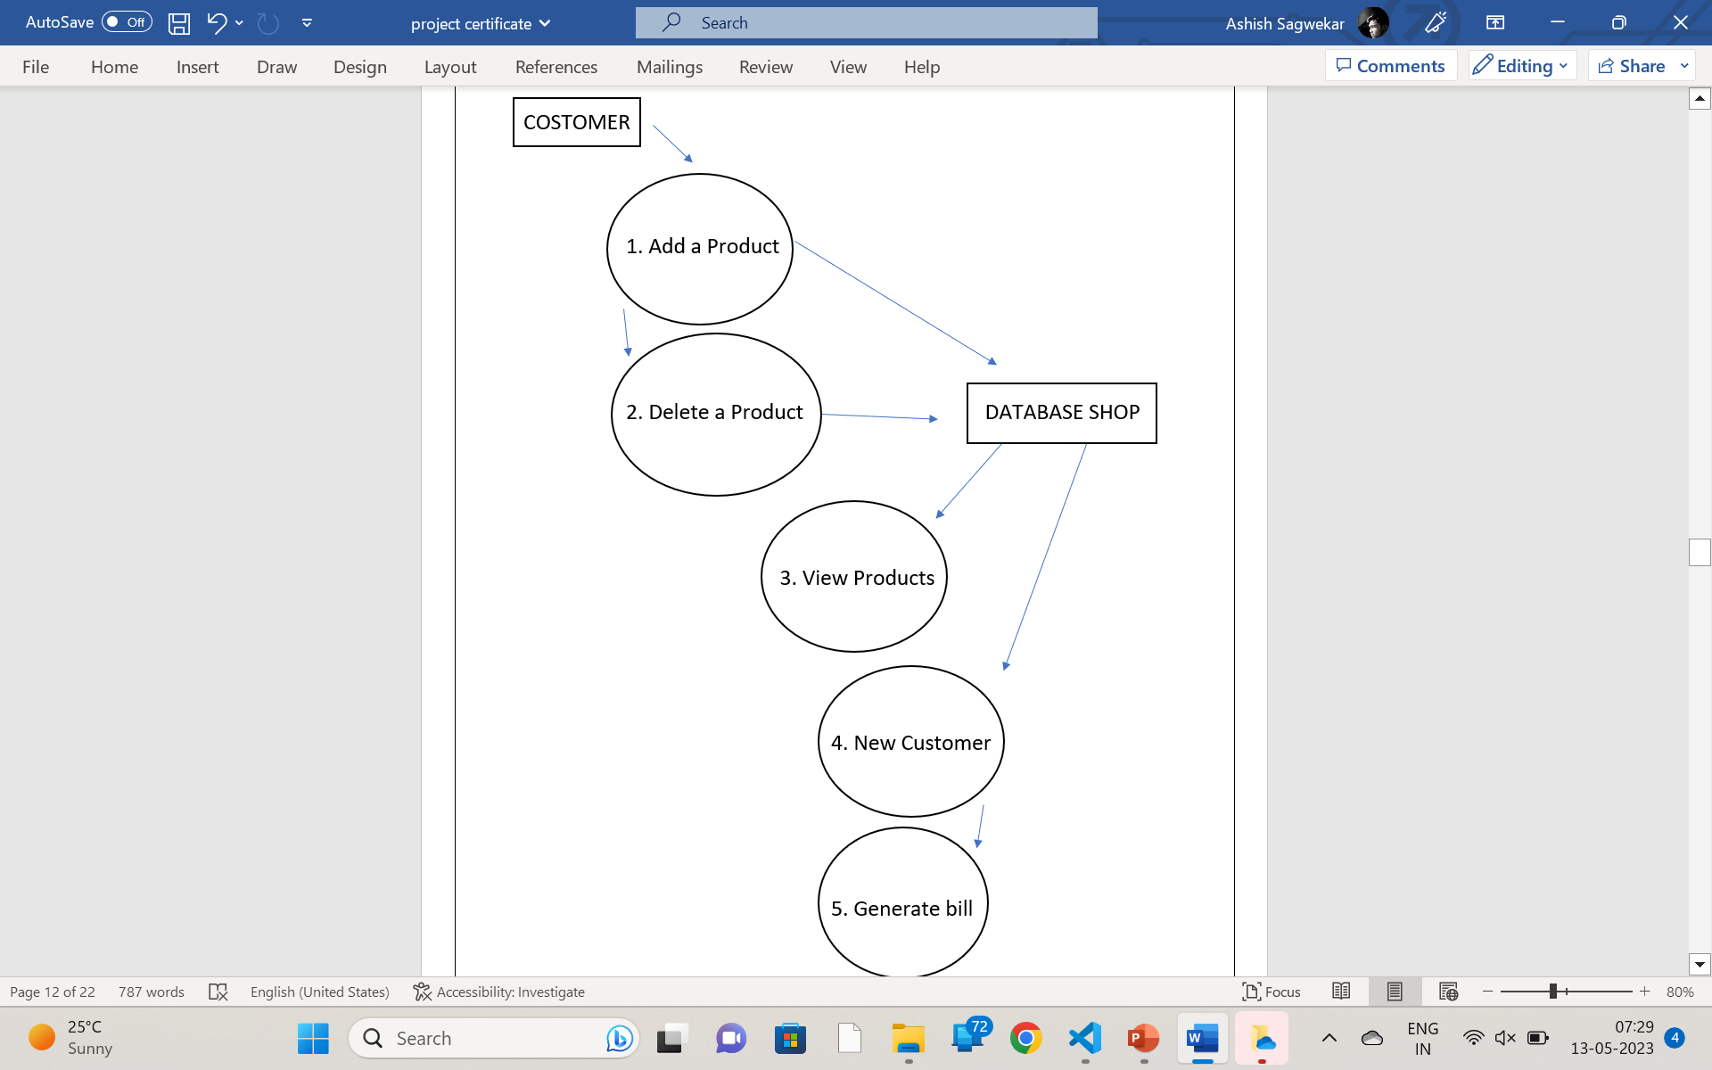
Dfd diagram

Slide 13
Thank you!!...

